Slide 1
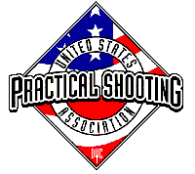
 | Easy To Hard –or– Hard to Easy
START POSITION: Handgun-ers need both hands on a set of Xs. PCC-ers need one hand on an X.
GUN READY CONDITION: Handgun loaded and holstered, PCC buttstock on belt facing down range. |  | SCORING: Comstock, 24 rounds, 120 points TARGETS: 12 USPS SCORED HITS: Best 2 per paper START-STOP: Audible - Last shot RULES: USPSA current edition
STAGE PROCEDURE: Upon start signal, engage targets as visible from within shooting area.
Shooting Area

Slide 2
Stage Setup Notes:
I would like the long shots at 15-20 yards and the short shots no less that 7 yards. I would like all target on the very back of the range.
May need to stagger the walls a bit on the trap side so they are not hit on through shots on angle based on width of the shooting lane between the walls.
Barrel in the middle should be set so you can hose the 4 standing in front of the barrel but if not, only three of the four are visible from the shooting zone at the end of the wall if possible.
Be careful placing the end targets so the shooting angle hits the trap. May need to adjust.

